Slide 1
Massively Parallel Astronomic Event Detection using GPU’s
Matthias Alexander Lee
Wentworth Institute of Technology
Dr. Pavlos Protopapas
Help and Moral support:
Richard Edgar, Mike Clark and Tom Buckley
Notes:
Doug: The wikipedia of programming
Richard: Help with CUDA
Ros Reid: making it possible for me to be here
Dom: Entertaining me

Slide 2
What are we detecting?
Trans-Neptunian-Objects
Light Curves
Brightness of a star graphed over time
Massive Data Sets

Slide 3
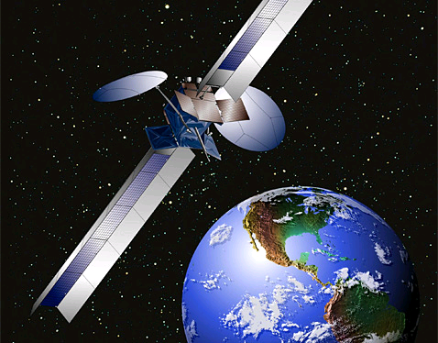
Where’s the Data from?
Whipple
Proposed NASA satellite
Monitors 10,000 stars
40hz 86,400s/day
Total of 3.456*10^10
Notes:
So where does the data come from?

Slide 4
Search Method: Sliding Window Cross Correlation
Generate Templates
Notes:
Generate templates of occultations where the objects have different parameters, such as size, speed and distance from the earth
But since they are symmetric we only need half the template.
We generate templates that match a wide variety of parameters

Slide 5
Search Method: Sliding Window Cross Correlation
Generate Templates
Notes:
Generate templates of occultations where the objects have different parameters, such as size, speed and distance from the earth
But since they are symmetric we only need half the template.
This cuts the number of points to be compared in half.

Slide 6
Search Method: Sliding Window Cross Correlation
Generate Templates
Event Detected!
Notes:
Generate templates of occultations where the objects have different parameters, such as size, speed and distance from the earth
But since they are symmetric we only need half the template.
This cuts the number of points to be compared in half.

Slide 7
The Code: part I
2 Main Function.
PreProc()
Reads in Templates
Normalizes Templates
Generates
Binary: contains all data
Dicionary: contains metadata about templates
Notes:
Generate templates of occultations where the objects have different parameters, such as size, speed and distance from the earth
But since they are symmetric we only need half the template.
This cuts the number of points to be compared in half.

Slide 8
The Code: part II
2 Main Function.
PreProc()
SearchLC()
Reads binary of Templates and Lightcurve
Stores at Texture
Launches 30 blocks of 64 threads per LC
Ensures shared memory is kept low enough for 2 blocks to be active on a multiprocessor, therefore hiding latency
Notes:
Generate templates of occultations where the objects have different parameters, such as size, speed and distance from the earth
But since they are symmetric we only need half the template.
This cuts the number of points to be compared in half.

